Slide 1

Software Project Management
Dr. Sumaira Nazir
Assistant Professor
Department of Software Engineering
National University of Modern Languages, Islamabad

Slide 2
Software Project?

Slide 3
Project
A project is “a temporary endeavor undertaken to create a unique product, service, or result.
Examples of IT Projects

Slide 4
Project Constraints?

Slide 5
Project Constraints
Every project is constrained in different ways, often by its scope, time, and cost goals.
These limitations are sometimes referred to in project management as the triple constraint.
To create a successful project,
a project manager must consider scope, time, and cost and balance these three often-competing goals

Slide 6
Project Constraints Cont.
Scope:
What work will be done as part of the project? What unique product, service, or result does the customer or sponsor expect from the project? How will the scope be verified?
Time:
How long should it take to complete the project? What is the project’s schedule? How will the team track actual schedule performance? Who can approve changes to the schedule?

Slide 7
Project Constraints Cont.
Cost:
What should it cost to complete the project? What is the project’s budget? How will costs be tracked? Who can authorize changes to the budget?

Slide 8
Project Constraints Cont.
Each area— scope, time, and cost—has a target at the beginning of the project

Slide 9
Project Constraints Cont.
Managing the triple constraint involves making trade-offs between scope, time, and cost goals for a project.
For example, you might need to increase the budget for a project to meet scope and time goals.
Alternatively, you might have to reduce the scope of a project to meet time and cost goals.

Slide 10
Project Constraints Cont.
Experienced project managers know that you must decide which aspect of the triple constraint is most important.
If time is most important, you must often change the initial scope and cost goals to meet the schedule.
If scope goals are most important, you may need to adjust time and cost goals

Slide 11
Project Management?

Slide 12
Project Management
Project management is
the application of knowledge, skills, tools, and techniques to project activities to meet project requirements

Slide 13
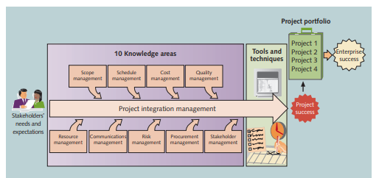
Project Management Framework
Figure : Project Management Framework

Slide 14
Project Management Knowledge Areas

Slide 15
Project Management Knowledge areas
Project management knowledge areas describe the key competencies that project managers must develop

Slide 16
Project Management Knowledge areas cont.
1.Project scope management
2. Project schedule management
3. Project cost management
4. Project quality management
5. Project resource management
6. Project communications management
7. Project risk management
8. Project procurement management
9. Project stakeholder management
10. Project integration management

Slide 17
Project Management Knowledge areas cont.
1- Project scope management
involves defining and managing all the work required to complete the project successfully.
2- Project schedule management
(formerly called project time management) includes estimating how long it will take to complete the work, developing an acceptable project schedule, and ensuring timely completion of the project.

Slide 18
Project Management Knowledge areas cont.
3. Project cost management
consists of preparing and managing the budget for the project.
4. Project quality management
ensures that the project will satisfy the stated or implied needs for which it was undertaken.

Slide 19
Project Management Knowledge areas cont.
5- Project resource management
is concerned with making effective use of the people and physical resources involved with the project.
6- Project communications management
involves generating, collecting, disseminating, and storing project information.

Slide 20
Project Management Knowledge areas cont.
7. Project risk management
includes identifying, analyzing, and responding to risks related to the project.
8. Project procurement management
involves acquiring or procuring goods and services for a project from outside the performing organization

Slide 21
Project Management Knowledge areas cont.
9. Project stakeholder management
includes identifying and analyzing stakeholder needs while managing and controlling their engagement throughout the life of the project.
10. Project integration management
is a crucial function that affects and is affected by all of the other knowledge areas.

Slide 22
Project Management Knowledge areas cont.
Project integration management is the coordination of all elements of a project.
This includes coordinating tasks, resources, stakeholders, and any other project elements, in addition to managing conflicts between different aspects of a project, making trade-offs between competing requests, and evaluating resources.

